Slide 1


QR Code Locker System
Project 5
Internet of Things | Year 3
Loti Ibrahimi (20015453)

Slide 2



Overview
Introduction
Equipment and Software
Current Progress
Further Development Plan

Slide 3
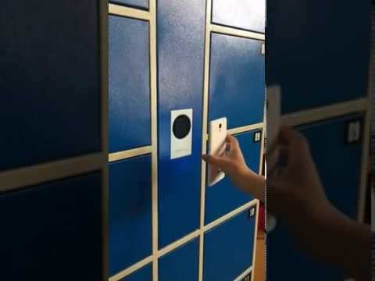
Introduction
Short video of an existing QR locker:
LOQR is a QR code locker system - another means of locking, without the use of keys.
QR codes are easy to generate and can be created in multiple forms – hard copy & soft copy.
Smart locker systems which use QR codes to be unlocked already exit out there.
Can be used in businesses, gyms, schools and colleges etc.
https://www.youtube.com/watch?v=5xm1hT7D_5k

Slide 4
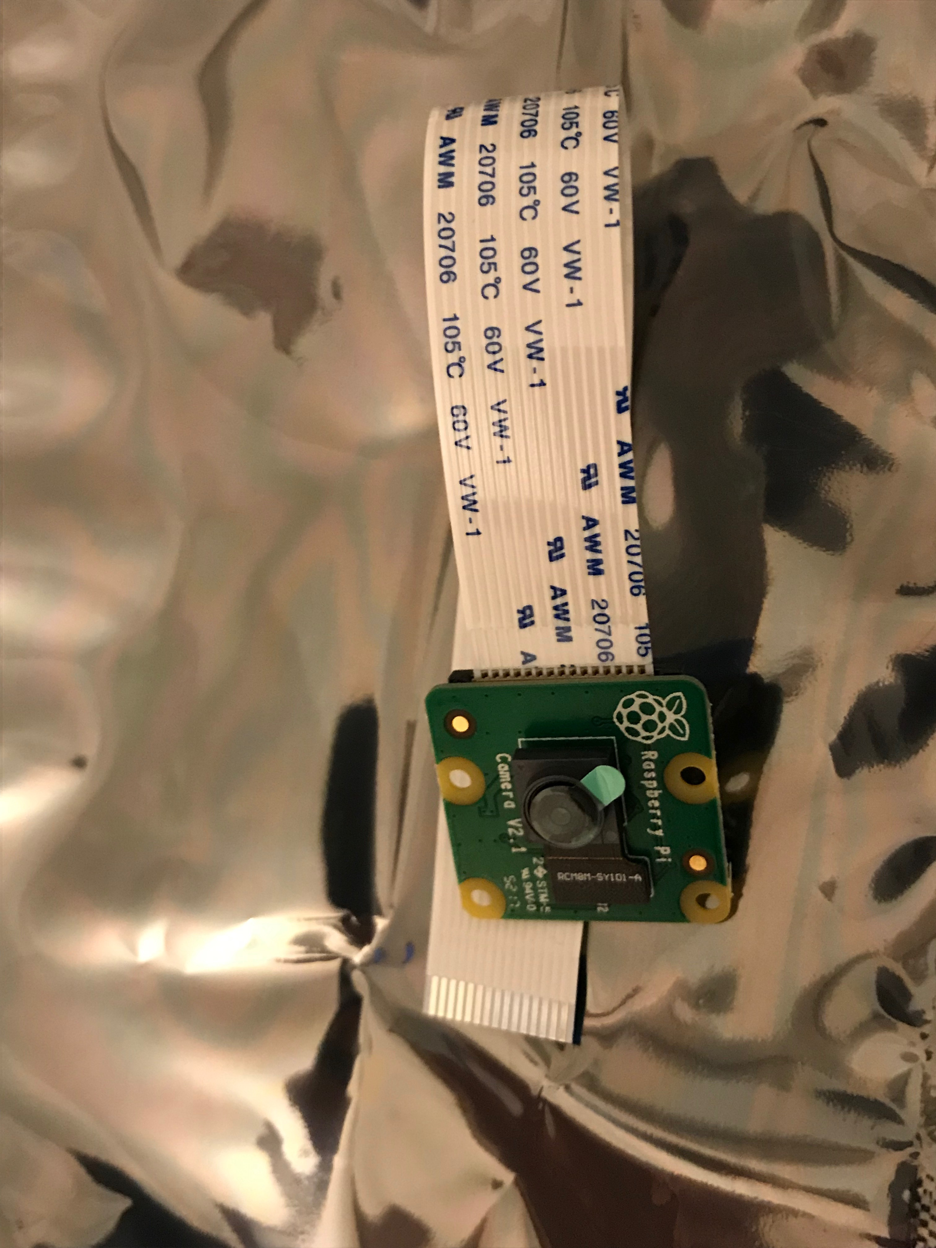
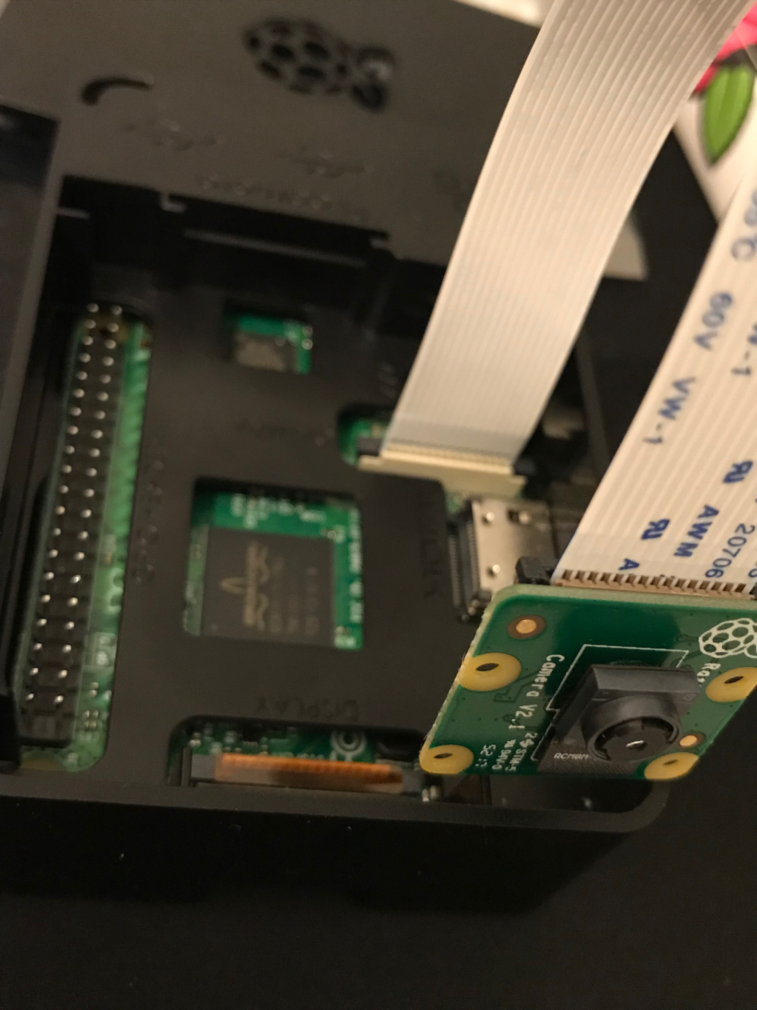
Equipment
Raspberry Pi 3
Pi Camera
Servo (possibility)
LEDS (to emulate lock/unlock)
Equipment

Slide 5



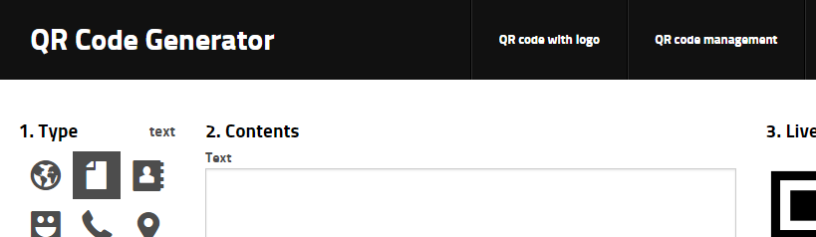
Software
Software for RPi
Zbar - module that will process the QR codes.
SimpleCV - an image processing library.
goqr.me - QR Code Generator

Slide 6
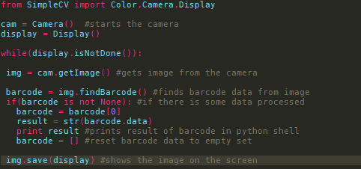
Current Progress
Attempts made using different methods of QR code scanning/code samples, which are making use of the Pi Cam.
Pi Cam doesn’t seem to be recognised by SimpleCV so will require a uv4l driver for it to work it seems.
Getting bar codes scanned is what I’ve been working on lately.
Still need to do more work with regard to further implementation, and not simply read bar codes as is.

Slide 7

Further Development Plan
I plan to work on this further, to not only read QR codes but to store a specific code and act upon it once that one is read.
The actuator for this would likely be a simple servo turning to represent a lock (locking/unlocking)
To create a short demo video showing the implemented features above.

Slide 8
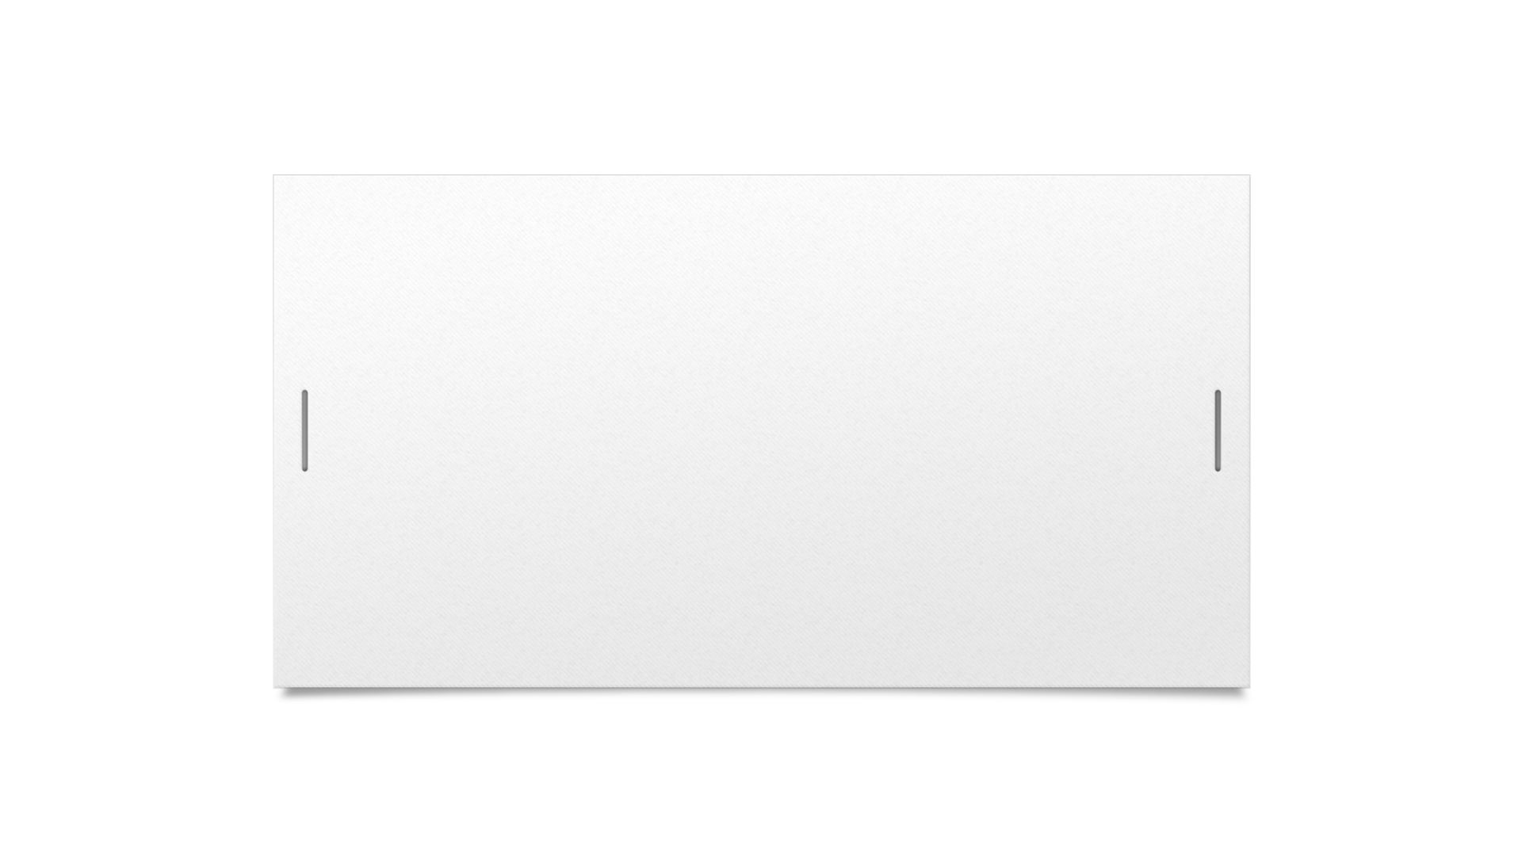

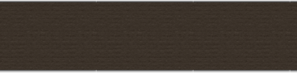
Thank You

